Slide 1
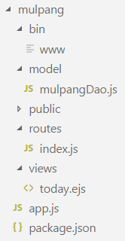
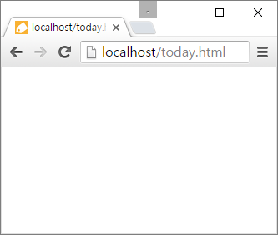

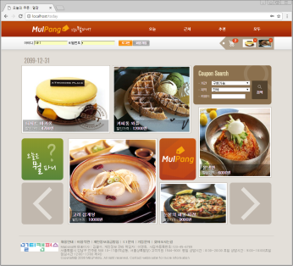

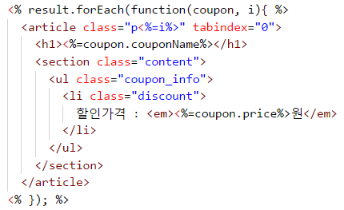
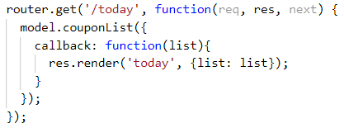

http://localhost/today 요청
www
Web browser
1
Controller
2
app.js
logger
Model
bodyParser
cookieParser
mulpangDao.js
static 자원처리
3
session
5
......
router
7
error handling
6
View
9
4
MongoDB
today.ejs
view engine(ejs)
8
routes/index.js

Slide 2
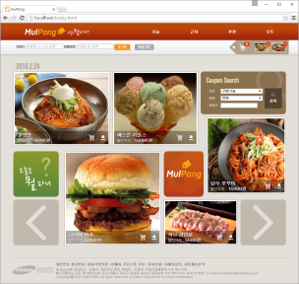
Controller
www
app.js
router
bodyParser
……
users.js
cookieParser
Model
index.js
session
...
router
mulpangDao.js
error handling
View
MongoDB
Oracle
today.ejs
MySQL

